Slide 1

ECE241 Project Demo
Runze Zhao (Harry), Maria Kahale

Slide 2

1. Project Overview
Introducing PitchPerfect! – a captivating music game designed to enhance players' note recognition skills. The game offers two engaging modes: Training and Gaming.
In Training Mode, players face individual notes presented one at a time. Using the PS2-Keyboard, they must correctly identify each note from the melodic sequence (C-do, D-re, E-mi, F-fa, G-so, A-la, B-ti). Progressing to the next note occurs upon the successful identification of the current one. The objective is to navigate through all single notes with precision and accuracy.
Switching to Gaming Mode, players encounter a challenging string of notes. Initially set to a default 1-second interval, players can dynamically adjust the note output speed using switches. This feature allows them to fine-tune the game's difficulty. To proceed, players input the corresponding notes on the PS2-Keyboard and seamlessly move to the next string by pressing the "N" key for "Next." PitchPerfect! promises an immersive musical experience, combining training and gaming for an entertaining journey in note recognition mastery.

Slide 3
2. Harry’s Individual Component Overview
This is an overview of the components I covered in my individual work part. I will elaborate on them as I go through my demonstration of the game.
A. Building states and handling states of FSM [More than 10 states] (0.5 point)
B. Handling Audio Output (0.5 point)
C. Implementing datapath (0.25 - 0.5 point)
*** Extra Component I integrated beyond what was in my proposal ***:
D. Switches and Keys Input (0.25 point)
E. Handling Clock Crossing for Audio Clock and Clock_50 (0.25 point)
Total points covered: 1.75 - 2.0 points.

Slide 4
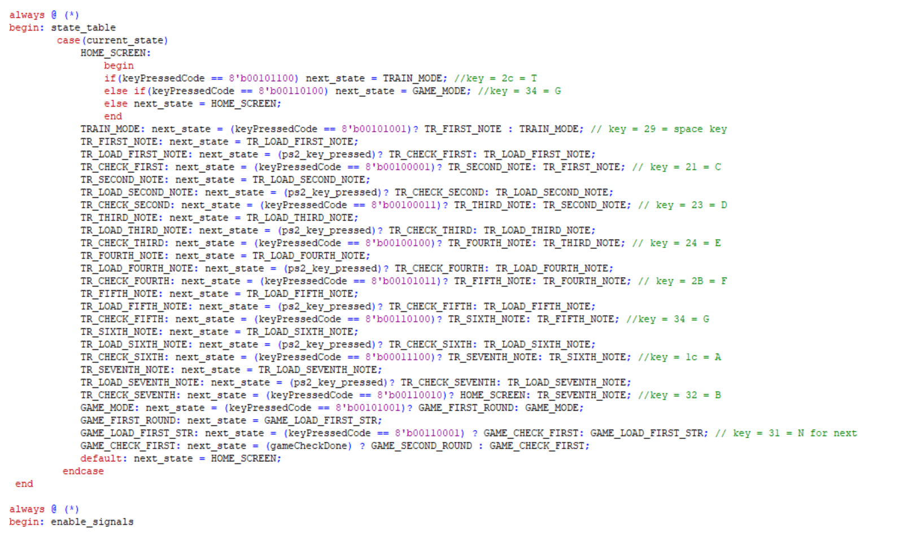
3a. FSM(0.5)
Highlight:
38 states in total.
Involves transition between states that differentiates training and gaming mode, takes in PS2-Keyboard input and outputs audio signal and corresponding game data.

Slide 5
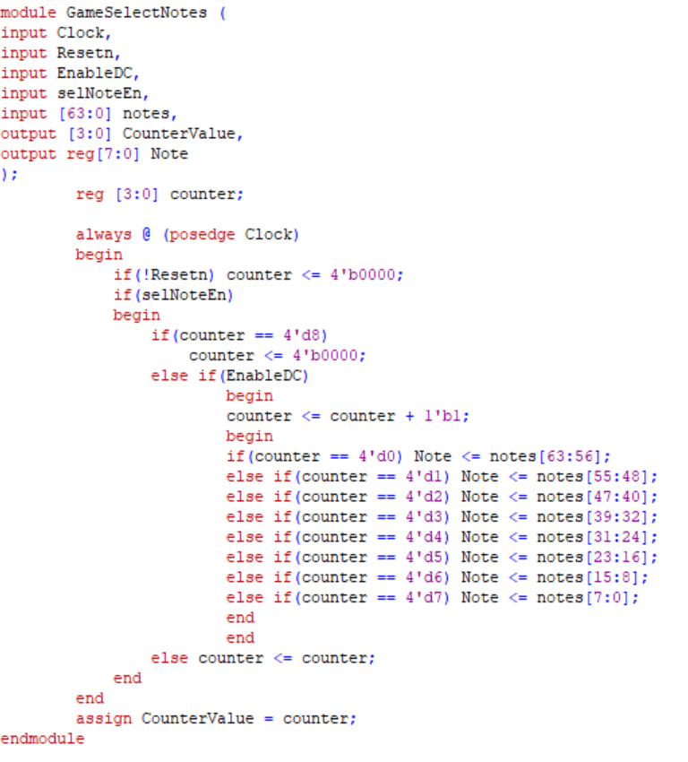
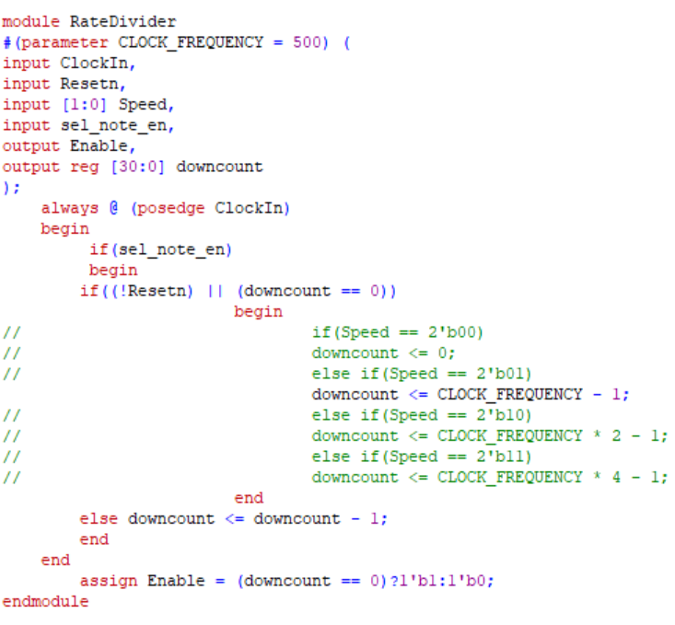
3b. Audio Output(0.5) + Clock-Crossing(0.25) + Keys/Switches(0.25)
Highlight:
Made use of the external audio module posted on course website to aid my design.
Added case handling statements to handle the flow of taking in keyboard input and output different note values - by adjusting the frequency of notes
Utilized RateDivider module and other modules I have written to aid in handling clock crossing, and to achieve the objective of outputting different notes at a customized speed (Players are encouraged to adjust the speed of outputting notes by using SW[9:8].

Slide 6
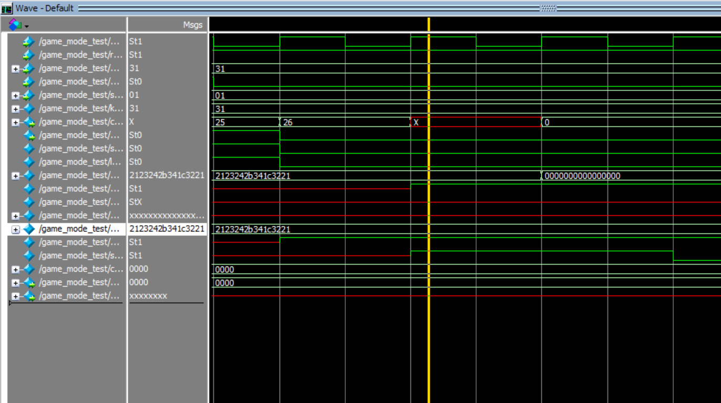
3c. Datapath (0.25 - 0.5 point)
Highlight:
Made use of enable signals that enables the functioning of different modules at desired states.
Utilized modules that control audio data : RateDivider(), GameSelectNotes().
Utilized module that controls loading of data: LoadStr().
Utilized module that controls processing of data: Game_Check_Str().
Area of Improvement: Due to limited time in lab, for the last part: Game_Check_Str(), I was only able to get the simulation working on Modelsim, attached is a screenshot of the waveform simulation.
The “Score” signal is output correctly (as 1) when player enters the correct string of notes

Slide 7
4. Group Integration Component
Highlight:
We were able to synchronize my part - FSM, audio output, with Maria’s part - PS2-Keyboard input, and successfully integrate all components and get them working properly on the FPGA: That is, our game successfully handles the clock-crossing between Clock_50, AUD_CLK, and PS2_CLK, and is able to produce desired results real time.
We utilized the audio module as the top level module because it also includes PIN_ASSIGNMENTS for PS2-ports and HEX_DISPLAY-ports, and was able to successfully compile and run the PS2-Keyboard module and all game modules within the top level audio module.
Area of Improvement: Due to limited time in lab, we did not have enough time to integrate the VGA design into the game, which Maria will present individually, along with her other individual part demonstration.

Slide 8
5. Maria’s Individual Component Overview
Here’s what I worked on for my VGA and keyboard tasks:
Static image (0.125 points)
Using Block Memories and larger on-chip memories (0.25 points)
PS2 keyboard/ PS2 mouse (0.5 points)
Handling clock crossing (between PS2_CLK and CLOCK_50 (0.25 points)
***Extra Components beyond the proposal ***:
Moving images with tearing allowed (0.25 points)
Small FSM; less than 10 states (0.25 points)
LEDs and 7-Seg display (0.125 points)
Switches and keys (0.25 points)
Total: ~1.75 pts.

Slide 9
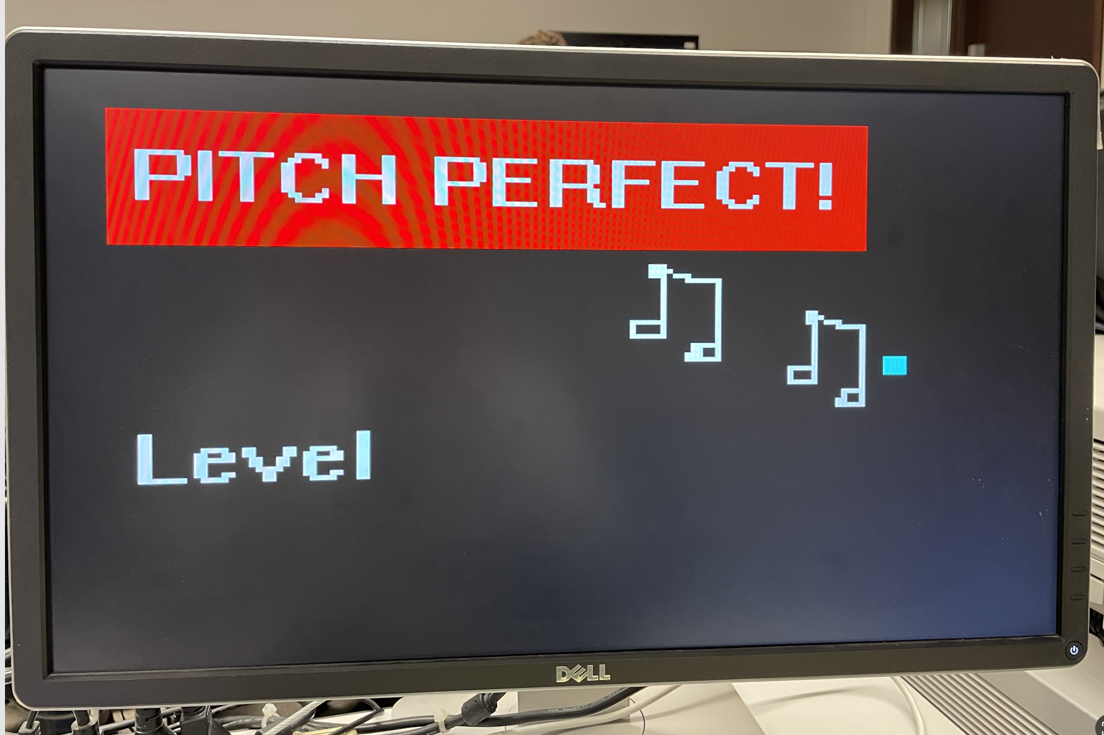
5A&C. VGA (0.125 static image + 0.25 moving square)
Highlight:
Used ROM to store mif file for VGA background image.
Displays the animated moving square
Visual indication of which level you are on
Areas for improvement:
Different screens for different game modes, involving different enable signals for different MIF memories.
Change the square into a moving MIF file.

Slide 10
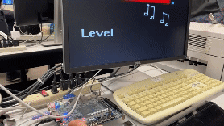
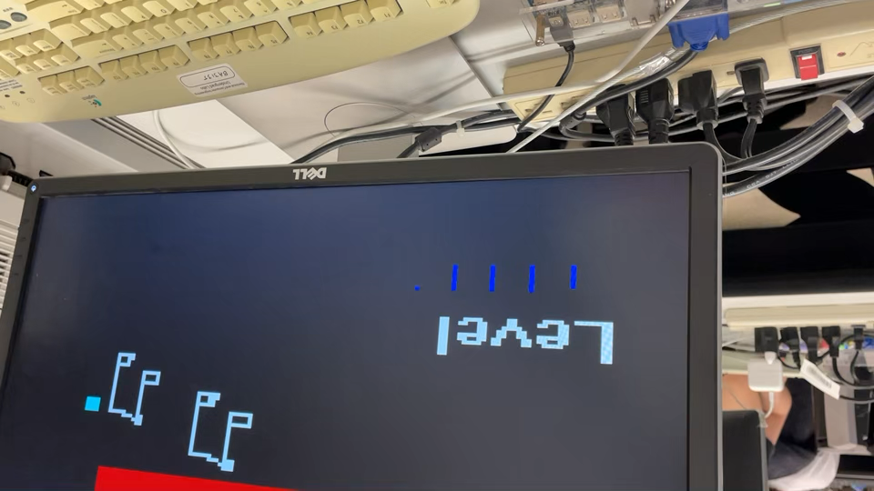
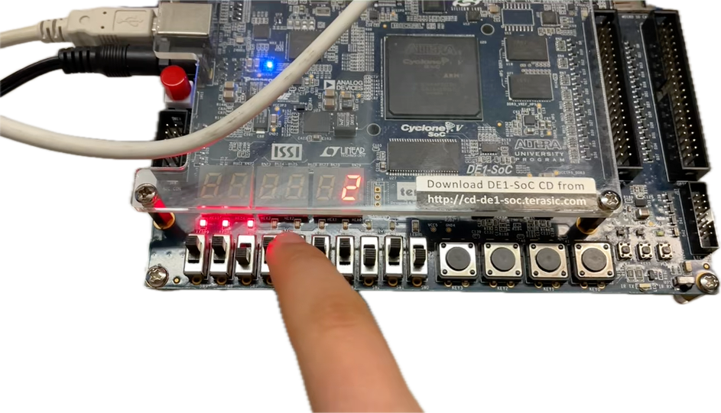
5D&E. Inputs and Outputs (0.25 Switches/Keys + 0.125 LEDs and HEX)
Highlights:
SW[9:8] used to control rate divider to adjust speed of moving square
HEX display connected to indicate animation speed.
SW[1:0] used to select square color.
LEDR[9:6] used to indicate which level the player is on.
SW[6:5] to select which level the player is on

Slide 11
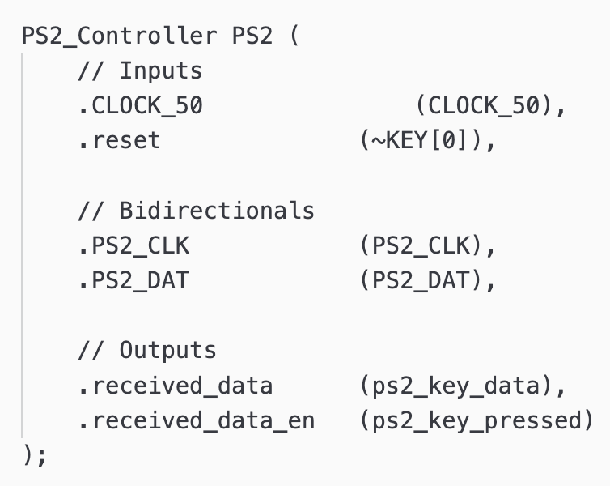
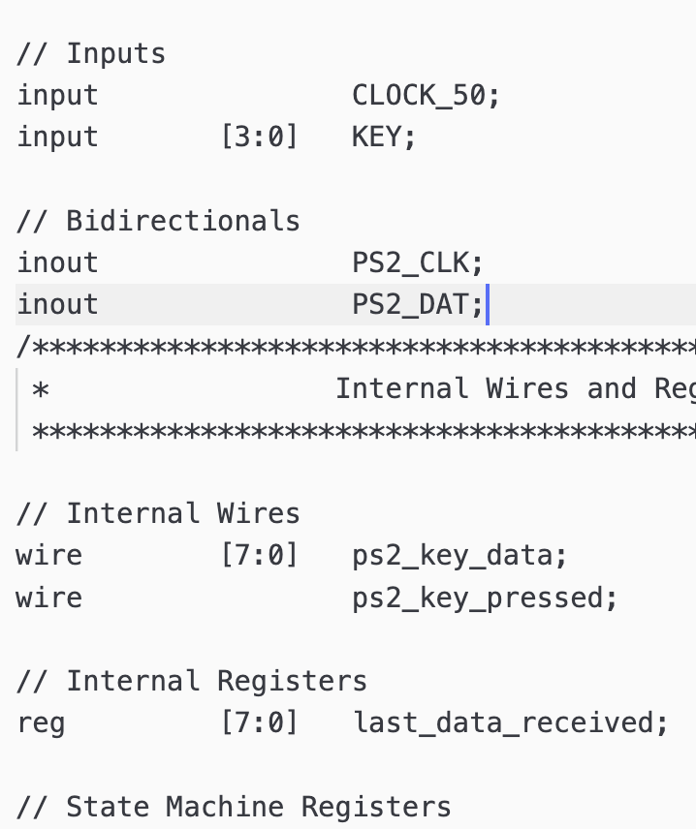
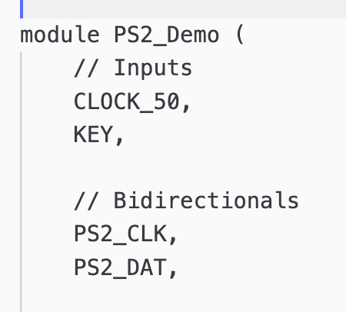
5B. 0.25 PS2 keyboard + 0.25 PS2_CLK Crossing
Highlights:
Used template PS2 module to integrate its PS2_CLK signal as well as key output into Harry’s FSM (ps2_keypressed).
Area of Improvement: Due to limited lab time, the plan was to control VGA with both the keyboard as well as Harry’s FSM for different levels.

Slide 12

Thank you for listening through our demo session!

